Slide 1


TACTICAL COMBAT CASUALTY CARE COURSE
Module 4: Principles and Application of TFC
MODULE 4:
PRINCIPLES AND APPLICATION OF TACTICAL FIELD CARE (TFC)
TCCC TIER 1
All Service Members
TCCC TIER 2
Combat Lifesaver
TCCC TIER 3
Combat Medic/Corpsman
TCCC TIER 4
Combat Paramedic/Provider

Slide 2




Module 4: Principles and Application of TFC
TACTICAL COMBAT CASUALTY CARE ROLE-BASED TRAINING SPECTRUM
ROLE 1 CARE
NONMEDICAL PERSONNEL
MEDICAL PERSONNEL
YOU ARE HERE
STANDARDIZED JOINT CURRICULUM
2

Slide 3










Module 4: Principles and Application of TFC
1 x TERMINAL LEARNING OBJECTIVES
05
Given a combat or noncombat scenario, perform Tactical Field Care in accordance with CoTCCC Guidelines.
  Identify the importance of security and safety in Tactical Field Care. (CLS T5:E23)
  Identify basic principles of removal/extraction of casualties from a unit-specific platform. (CLS T5:E24)
  Identify the importance and techniques of communicating casualty information with unit tactical leadership and/ or medical personnel. (CLS T5:E25)
  Identify the relevant tactical and casualty data involved in communicating casualty information. (CLS T5:E26)
  Demonstrate communication of casualty information to tactical leadership and/or medical personnel (in accordance with Service and/or unit standard operating procedures in Tactical Field Care). (CLS T5:E27)
  Identify triage considerations in Tactical Field Care. (CLS T5:E28)
  Demonstrate the consolidation and triage of casualties in a casualty collection point.
7 x ENABLING LEARNING OBJECTIVES
= Terminal Learning Objectives = Cognitive ELOs = Performance ELOs
#
3

Slide 4



Three PHASES of TCCC
Module 4: Principles and Applications of TFC
1
CARE UNDER FIRE (CUF)
/ THREAT
2
TACTICAL FIELD CARE (TFC)
WORK UNDER COVER AND CONCEALMENT
3
TACTICAL EVACUATION CARE (TACEVAC)
RETURN FIRE AND TAKE COVER
MORE DELIBERATE ASSESSMENT AND PRE- EVACUATION PROCEDURES
YOU ARE HERE

Slide 5

CASUALTY COLLECTION POINT OVERVIEW
Video can be found on deployedmedicine.com

Slide 6

PHASE 2: TACTICAL FIELD CARE
Module 4: Principles and Application of TFC
TFC IS RENDERED WHEN THERE IS NO LONGER A DIRECT THREAT OR EFFECTIVE ENEMY FIRE
Having transitioned from Care Under Fire (CUF), further assessment and care can be more deliberate following the MARCH PAWS SEQUENCE
IMPORTANT CONSIDERATIONS:
This does NOT mean that the danger is over, the tactical situation could change back to CUF AT ANY TIME
Mission personnel should constantly maintain their situational awareness of the potential threat from hostile forces
TFC also encompasses the combat/tactical environment not involving enemy fire (e.g., parachute injury in a combat zone)

Slide 7
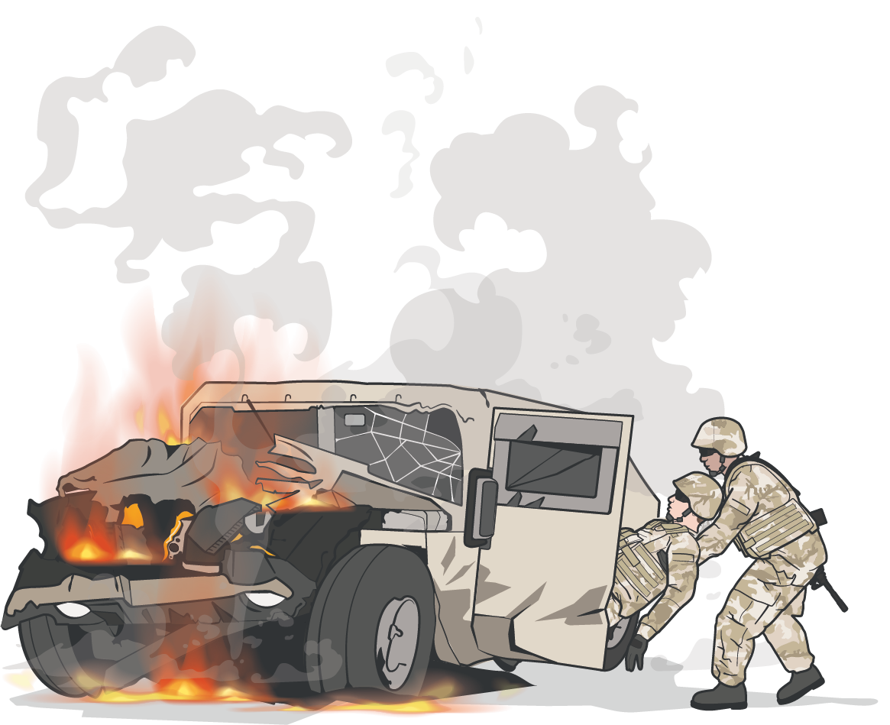
CASUALTY REMOVAL/EXTRACTION PRINCIPLES
Module 4: Principles and Application of TFC
PRINCIPLE 1:
SAFETY is critical.
PRINCIPLE 2:
MARCH still applies. If possible, you may want to initiate lifesaving measures (e.g., applying a TQ before extraction) and continuously monitor the casualty.
PRINCIPLE 3:
TRAINING
Extractions will vary based on the UNIT, MISSION, and VEHICLES
located in your area of responsibility

Slide 8
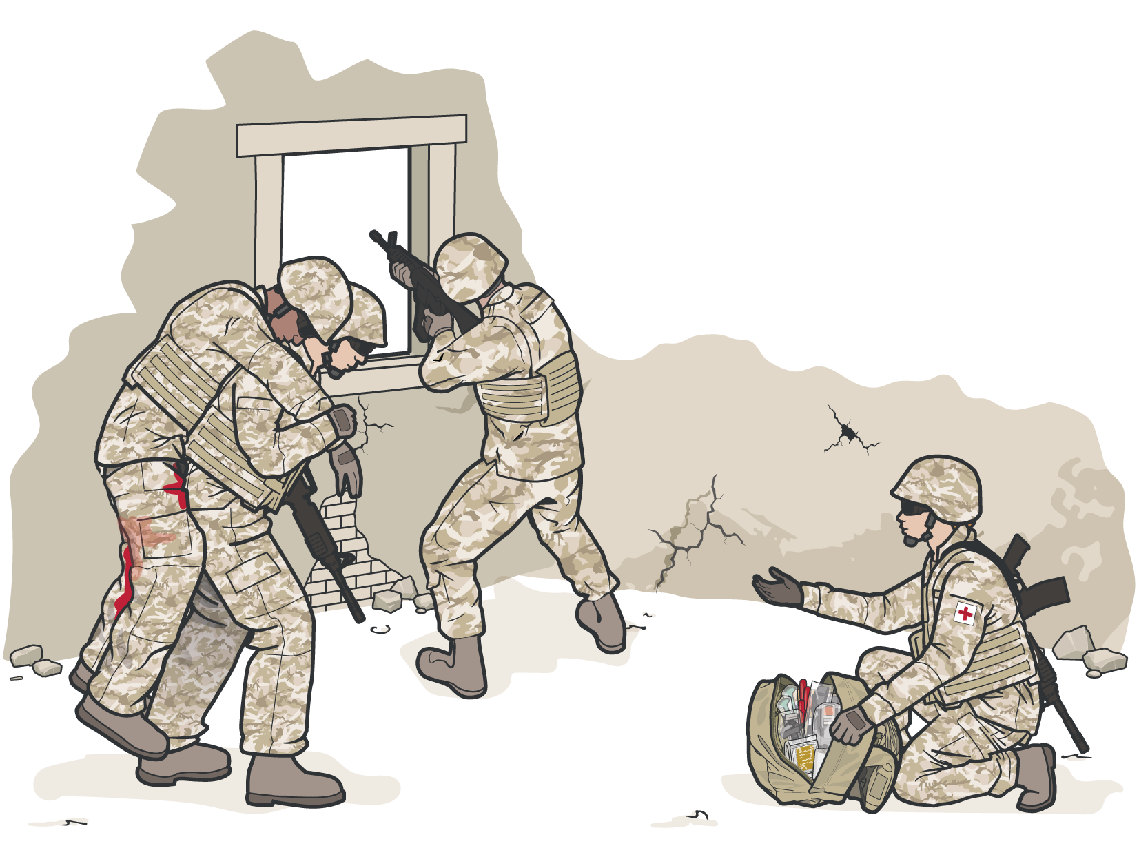
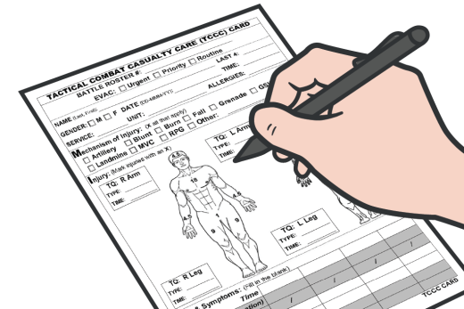
Module 4: Principles and Application of TFC
SECURITY AND SAFETY IN TFC
Combat Medic / Corpsmen should be ready to receive casualties in an area that provides adequate cover
COMMUNICATE with
the first responder and
casualty, if possible
Reassess lifesaving interventions that were done either in CUF or TFC by using the MARCH PAWS algorithm
If a first responder is available,
direct them to assist with exposing and treating the casualty as well as assist in setting up medical equipment and prestaging of litter, including documentation
DOCUMENT ALL assessment and medical care (including interventions and medications) on the DD Form 1380

Slide 9
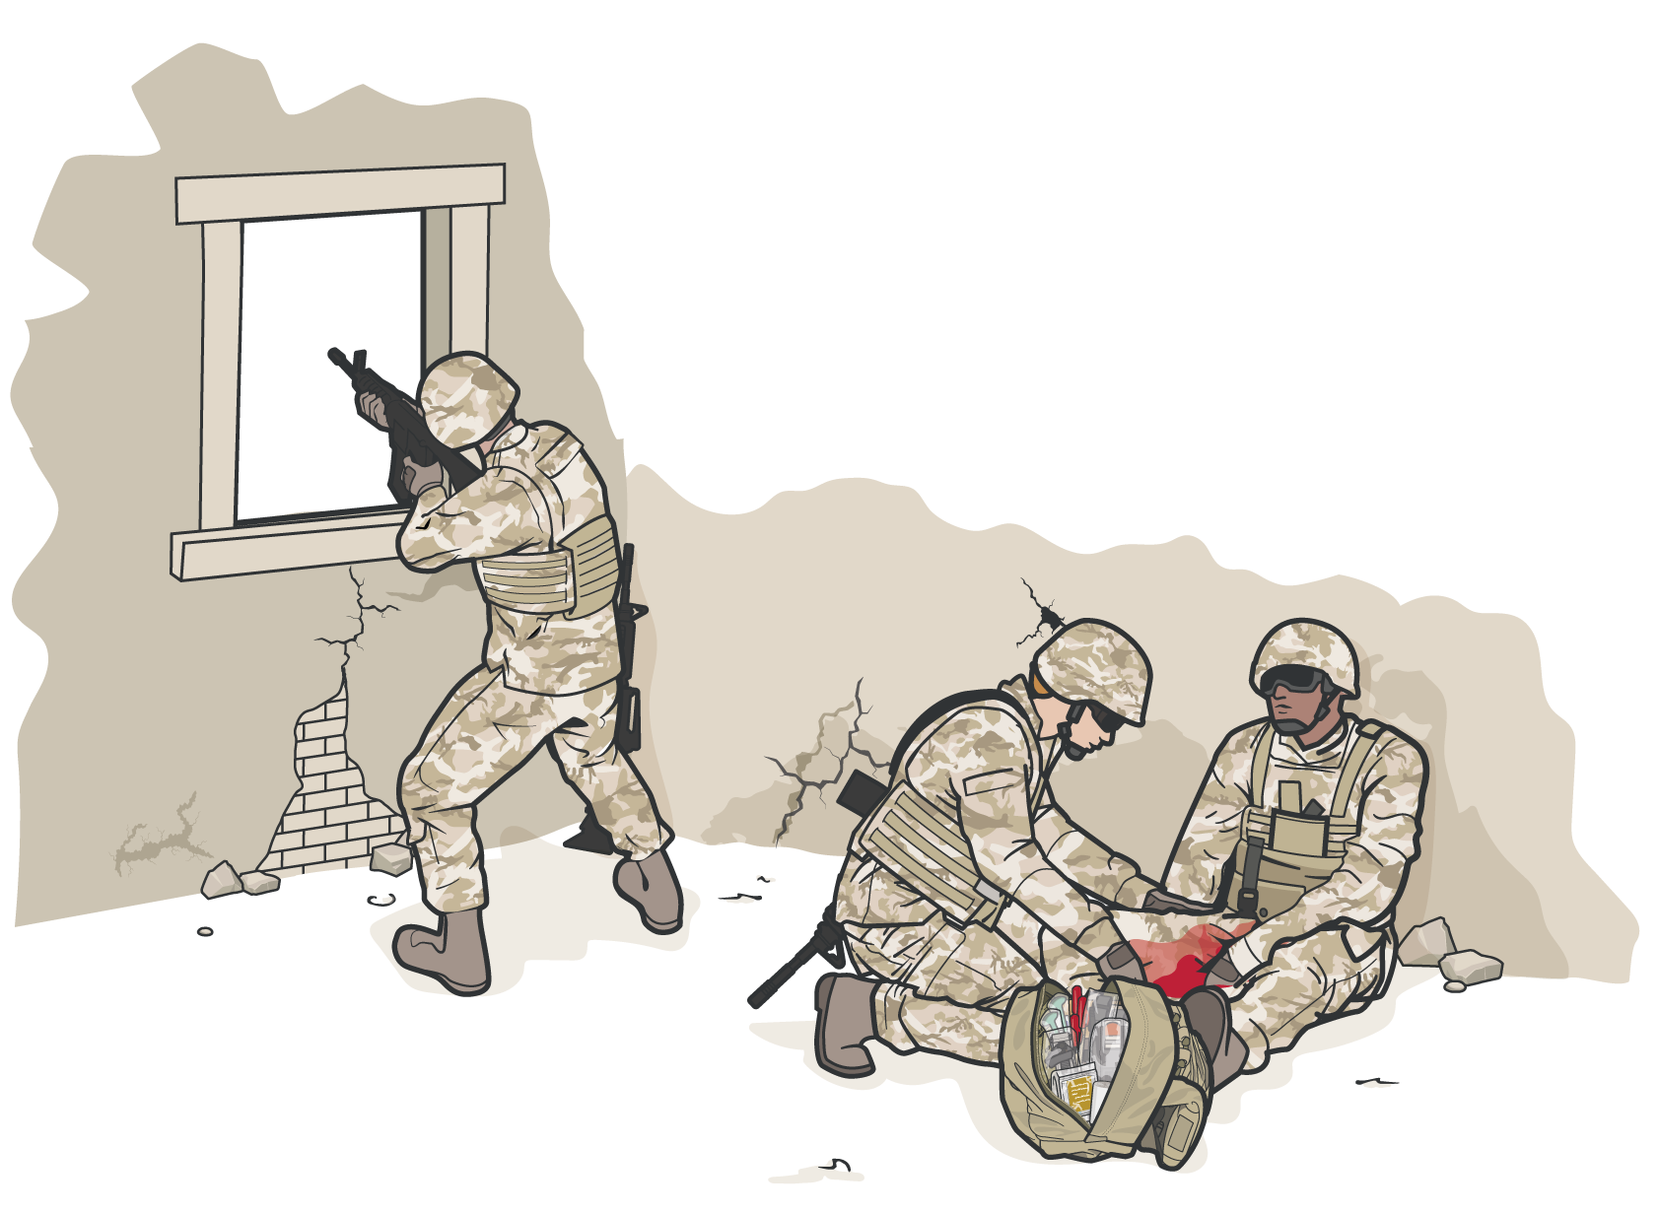


Module 4: Principles and Application of TFC
SECURITY AND SAFETY IN TFC
ESTABLISH a security perimeter in accordance with unit tactical standard operating procedures and/or battle drills
MAINTAIN tactical
situational awareness
CASUALTIES WITH ALTERED MENTAL STATUS SHOULD IMMEDIATLY HAVE:
Weapons cleared and secured Communications secured Sensitive items redistributed Weapons and radios DO NOT
mix well with shock, head injuries, or narcotics

Slide 10
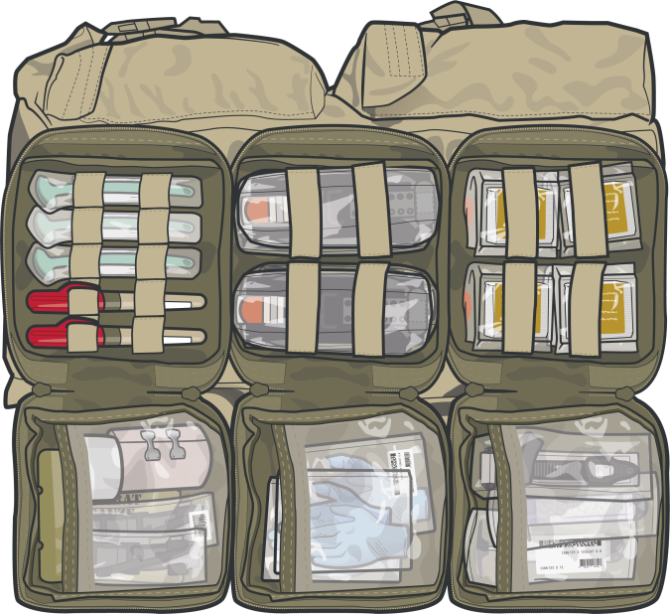
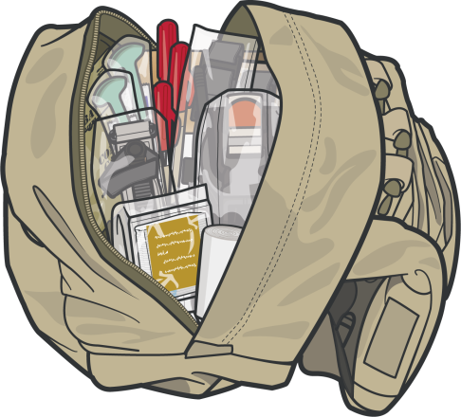
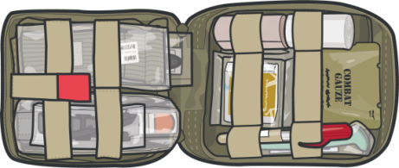
OTHER CONSIDERATIONS IN TFC
Module 4: Principles and Application of TFC
OUT OF DIRECT FIRE
TFC is when the casualty and the responder are
REMEMBER
NOT UNDER EFFECTIVE ENEMY FIRE OR DIRECT THREAT
Always use the
casualty's JFAK FIRST
TFC can turn into a CUF situation unexpectedly
Personnel should maintain their situational awareness at all times
Medical personnel and first responders should be prepared to move casualties on short notice
LIMITED SUPPLIES
Medical equipment and supplies are LIMITED to what the Combat Medic/Corpsman (CMC), other unit members, and the casualty carry on the mission

Slide 11
MARCH PAWS
DURING LIFE-THREATENING AFTER LIFE-THREATENING
M A R C H
P A W S
MASSIVE BLEEDING
#1 Priority
PAIN
AIRWAY
ANTIBIOTICS
RESPIRATION
WOUNDS
CIRCULATION
SPLINTING
HYPOTHERMIA / HEAD INJURIES

Slide 12
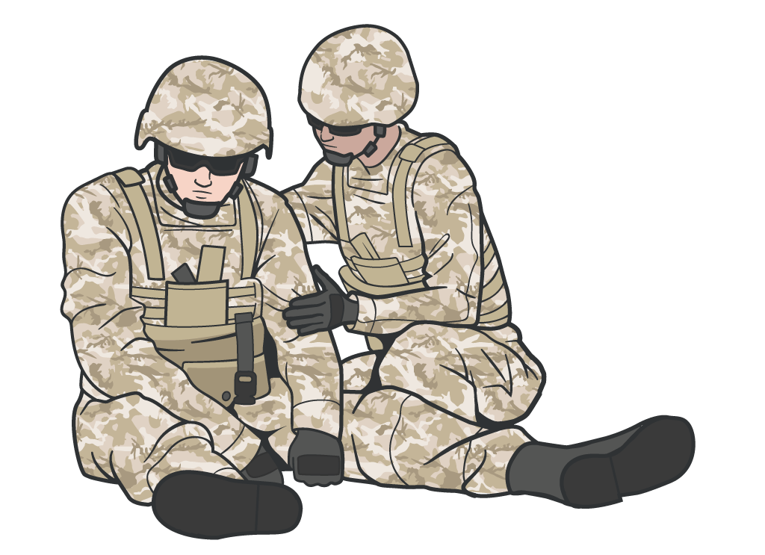
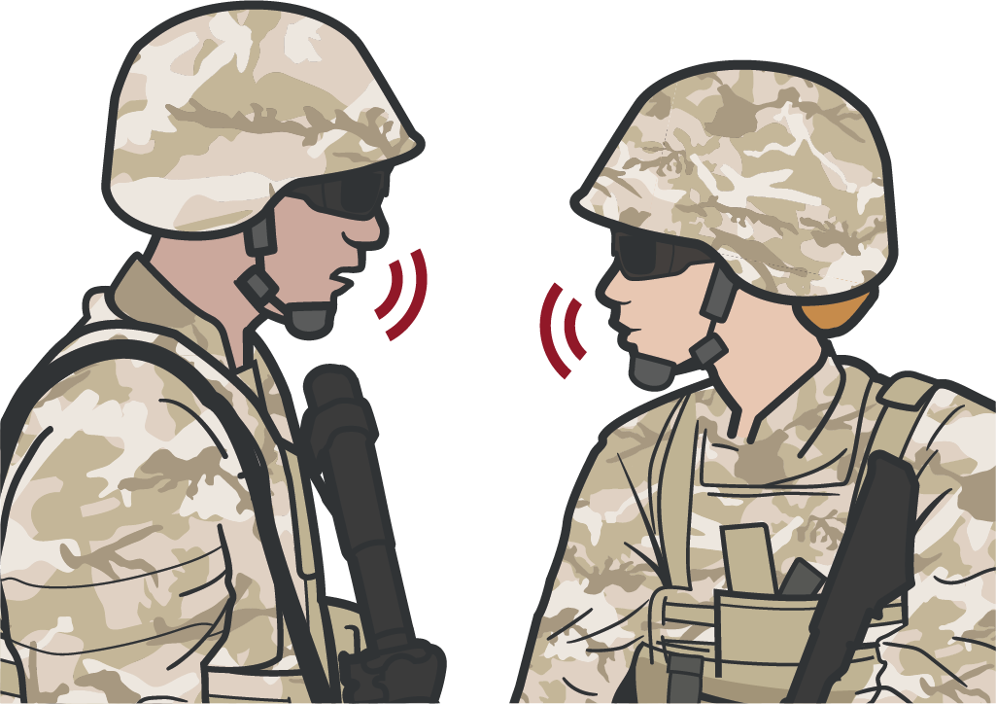
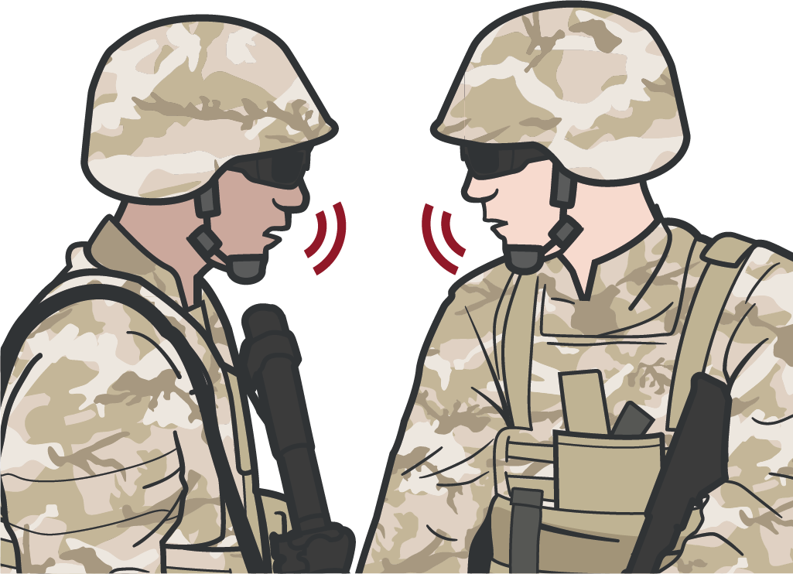
Module 4: Principles and Application of TFC
COMMUNICATION
COMMUNICATE with the
casualty
COMMUNICATE with first responders, other medical personnel, and tactical leadership about casualty injuries, condition, movement, and ongoing care
COMMUNICATE with tactical leadership IMMEDIATELY on evacuation requirements
Continue to communicate with leadership on casualty status as needed
ENCOURAGE REASSURE EXPLAIN CARE
(each step of the way)

Slide 13
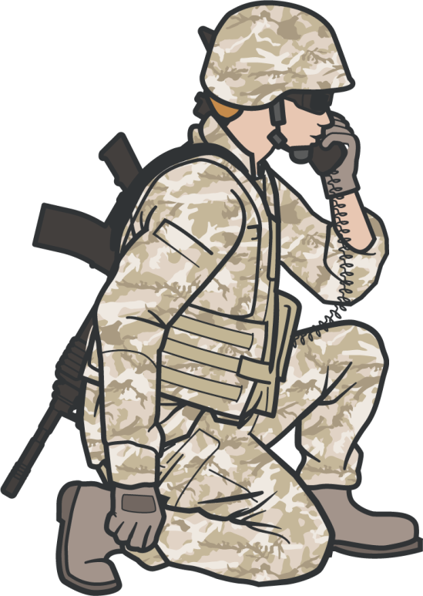
COMMUNICATE RELEVANT CASUALTY INFORMATION
Module 4: Principles and Application of TFC
DOCUMENT ALL assessment and medical care (including interventions and medications) on the DD Form 1380
Tactical Leadership will COMMUNICATE with evacuation assets using:
MEDEVAC request
MIST Report
_{M} echanism of injury
_{I} njuries
_{S} ymptoms
_{T} reatment
Relay casualty information following your unit standard operating procedures
COMMUNICATE CASUALTY DATA IN HAND-OFF WITH MEDIC OR MEDEVAC
When handing off the casualty to medic or MEDEVAC, read off DD Form 1380, including any additional information as needed
MIST report may change as the casualty status changes and in response to interventions performed

Slide 14
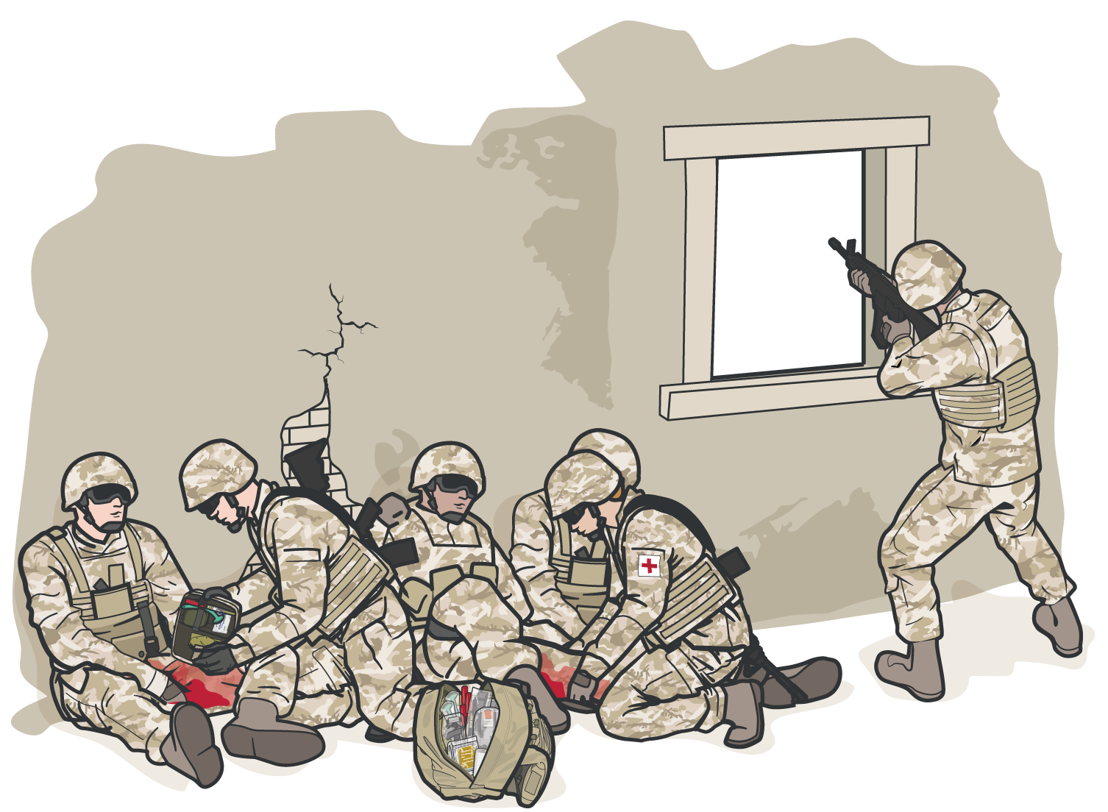
TRIAGE:
PRIORITIZING MULTIPLE CASUALTIES
Module 4: Principles and Application of TFC
Multiple casualties may need to be sorted into prioritized treatment groups
The CMC may be required to triage
casualties based on severity of injuries
The CMC will prioritize care for the most urgent casualties
First responder personnel can assist, care for less urgent casualties, monitor casualties after emergency interventions, and help prepare casualties for evacuation

Slide 15
TRIAGE CONSIDERATIONS
This would be an example of your immediate
Module 4: Principles and Application of TFC
#1
Massive Bleeding
#2
Airway Compromise
#3
Respiratory
#4
#5
Altered
HEMORRHAGIC
Distress Mental Status
SHOCK
#1 Priority Treatment

Slide 16



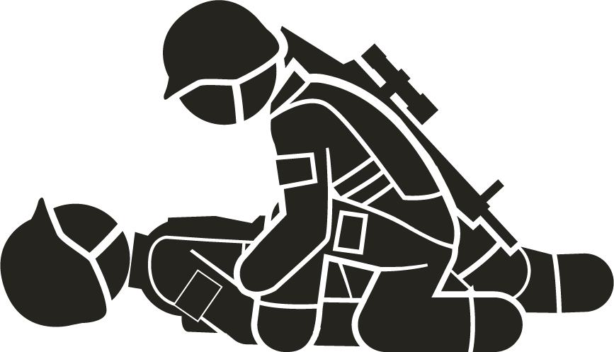


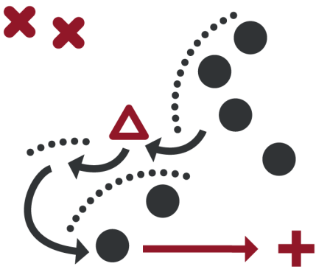
Module 4: Principles and Application of TFC
CASUALTY COLLECTION POINT CONSIDERATIONS
SECURITY
COMMAND
and CONTROL
Appropriate TRIAGE AND MEDICAL TREATMENT
Situational
AWARENESS
Control of EQUIPMENT and SUPPLIES
ORGANIZATION
ACCOUNTABILITY

Slide 17
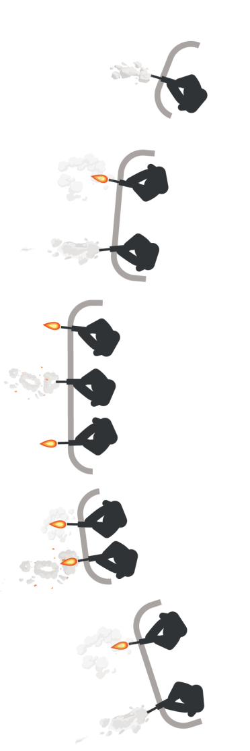
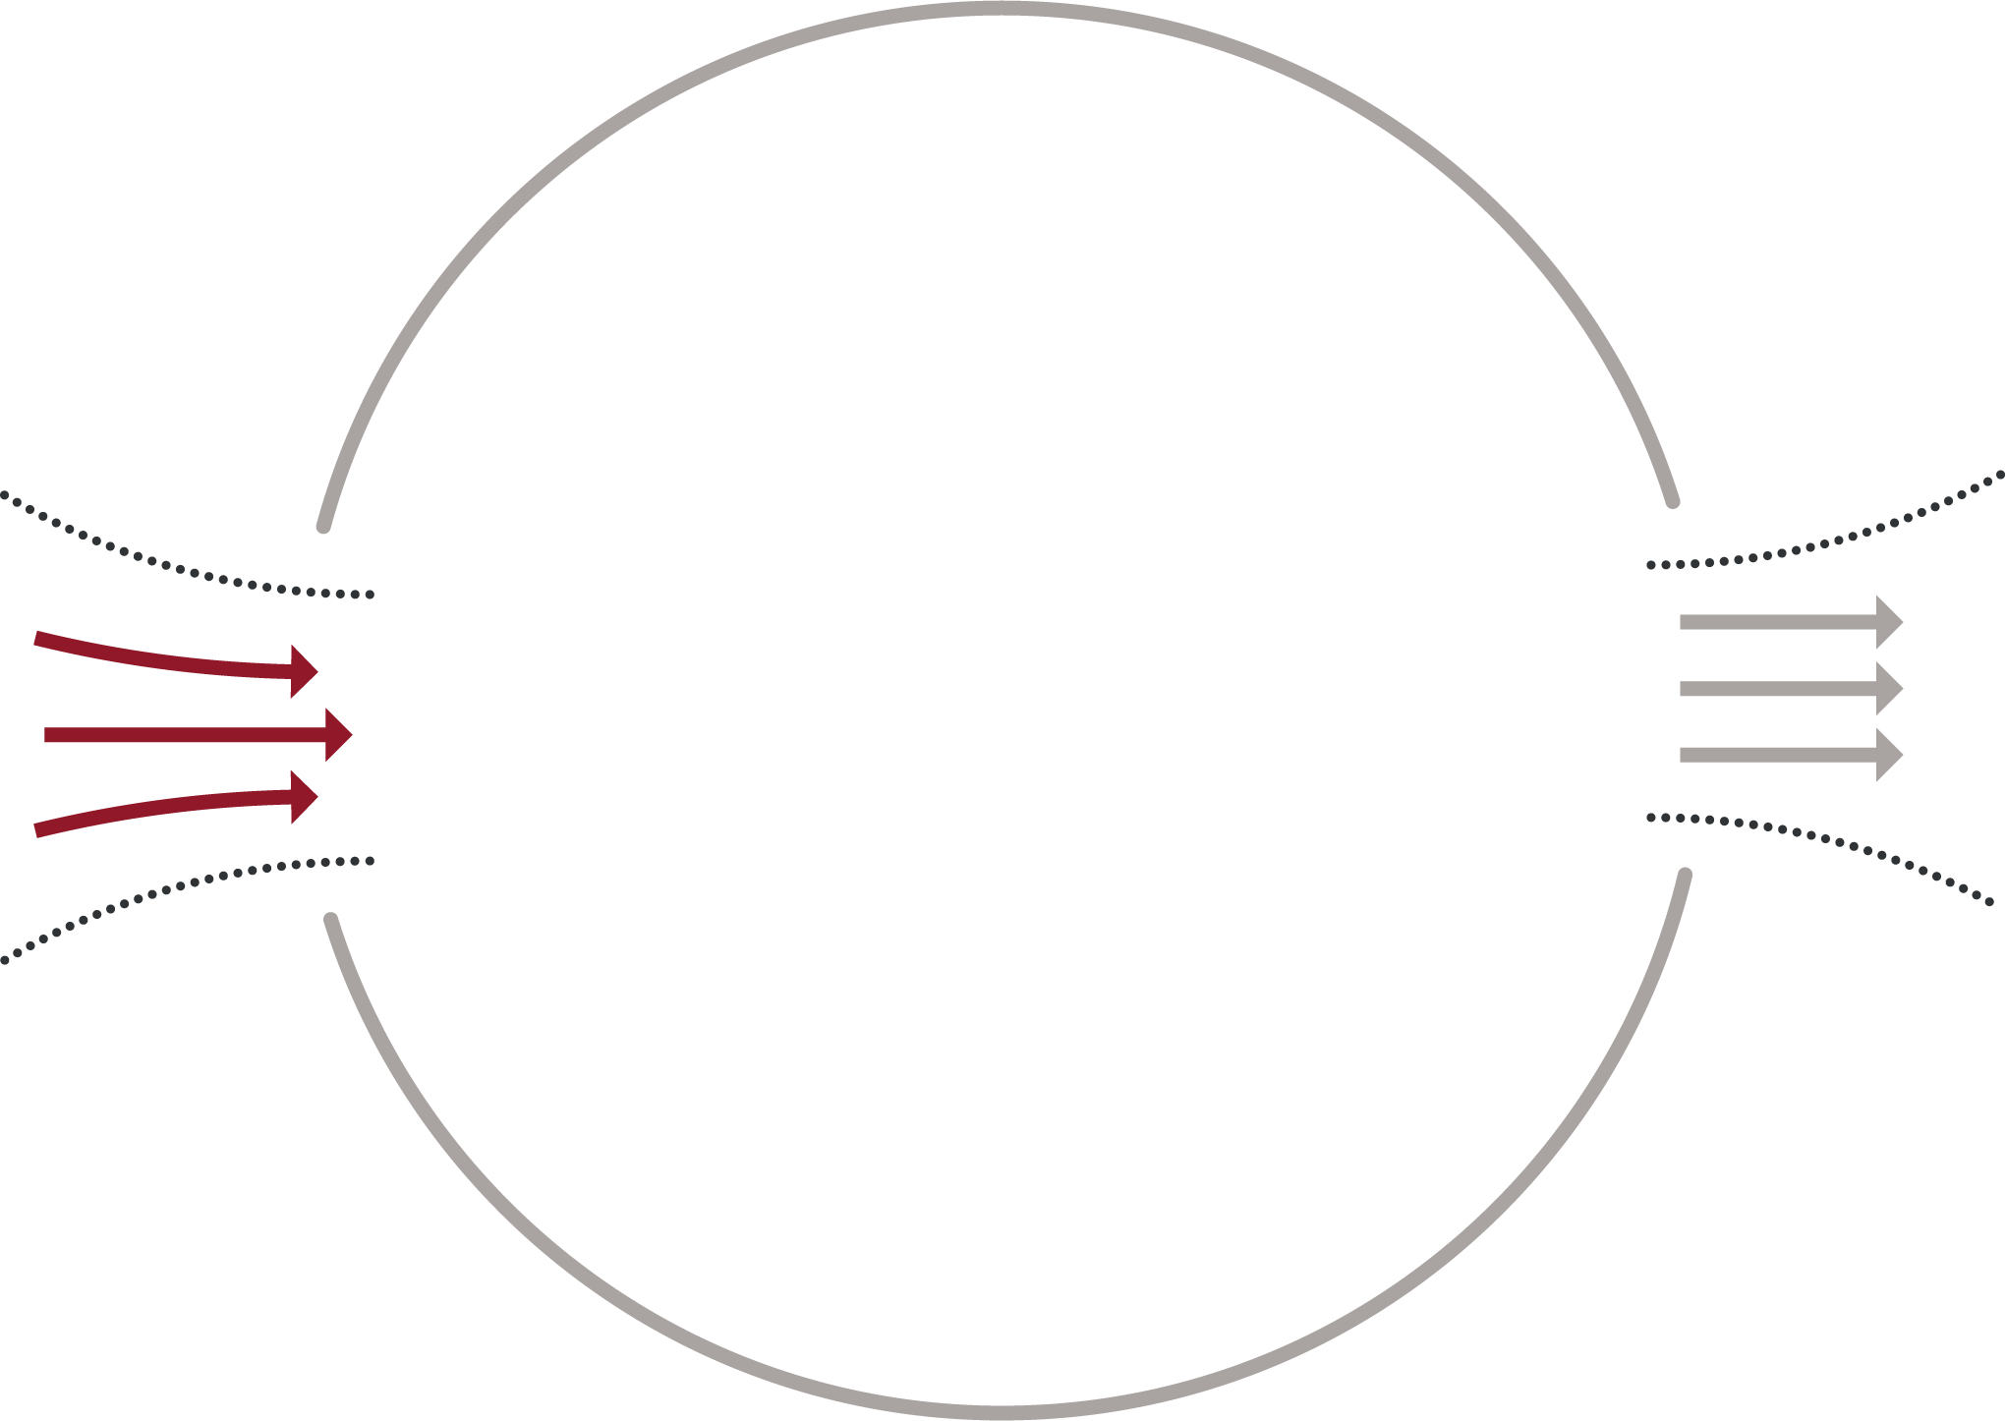






CASUALTY COLLECTION POINT
Module 4: Principles and Application of TFC
Locate CCP reasonably close to the fight
Locate near natural
"lines of drift"
Offer COVER and
CONCEALMENT from
the enemy
Have ACCESS TO EVACUATION ROUTES
Expectant/Minimal
Delayed
Immediate

Slide 18



Module 4: Principles and Application of TFC
CASUALTY COLLECTION POINT
LAYOUT AND RESPONSIBILITY considerations

Slide 19
Module 4: Principles and Application of TFC
CASUALTY COLLECTION POINT
LAYOUT AND RESPONSIBILITY considerations
Establish a security perimeter in accordance with unit tactical standard operating procedures and/or battle drills.

Slide 20
Module 4: Principles and Application of TFC
CASUALTY COLLECTION POINT
LAYOUT AND RESPONSIBILITY considerations
Casualty movement will be provided by unit personnel in accordance with unit tactical operating procedures and/or battle drills.
Incoming Casualties

Slide 21
Module 4: Principles and Application of TFC
CASUALTY COLLECTION POINT
LAYOUT AND RESPONSIBILITY considerations
TRIAGE
ENTRY CHOKEPOINT
Incoming Casualties
Triage/chokepoint will be unit leadership categorizing patients

Slide 22

Module 4: Principles and Application of TFC
CASUALTY COLLECTION POINT
LAYOUT AND RESPONSIBILITY considerations
TRIAGE
ENTRY CHOKEPOINT
Patients will then be placed in the Casualty Collection Point (CCP), which should be marked/identified
Incoming Casualties

Slide 23


Module 4: Principles and Application of TFC
CASUALTY COLLECTION POINT
LAYOUT AND RESPONSIBILITY considerations
IMMEDIATE
These casualties require an immediate lifesaving intervention (LSI) and/or surgery. Put simply, if medical attention is not provided, they will die. The key to successful triage is to locate these individuals as quickly as possible.
TRIAGE
ENTRY CHOKEPOINT
Incoming Casualties
IMMEDIATE

Slide 24


Module 4: Principles and Application of TFC
CASUALTY COLLECTION POINT
LAYOUT AND RESPONSIBILITY considerations
DELAYED
This cateTgoRrIyAinGcEludes those wounded who are likely to neEeNdTsRuYrgery, but whose general conditio^{C}n^{H}p^{O}e^{K}rm^{EP}it^{O}s^{IN}de^{T}lay in surgical treatment without unduly endangering the life, limb, or
eyesight of the casualty. Sustaining treatment will be required (e.g., oral or IV fluids, splinting,
_{Incomin}a_{g}dministration of antibiotics and pain control),
DELAYED
Casualties
but can possibly wait.
IMMEDIATE

Slide 25


Module 4: Principles and Application of TFC
CASUALTY COLLECTION POINT
LAYOUT AND RESPONSIBILITY considerations
TRIAGE
ENTRY CHOKEPOINT
MINIMAL
Incoming Casualties
MINIMAL
DELAYED
Casualties in this category are often referred as the “walking wounded.” Although these casualties may appear to be in bad shape at first, it is their phy^{I}s^{M}io^{M}lo^{E}g^{D}ic^{IA}st^{T}a^{E}te that tells the true story. Casualties who fit into the minimal category may not present themselves until late in the triage process.

Slide 26



Module 4: Principles and Application of TFC
CASUALTY COLLECTION POINT
LAYOUT AND RESPONSIBILITY considerations
TRIAGE
ENTRY CHOKEPOINT
MINIMAL
/EXPECTANT
Incoming Casualties
DELAYED
EXPECTANT
Casualties in this category have woIMunMdEs DthIaAtTaEre so extensive, that even if they were the sole casualty and had the benefit of optimal medical resources, their survival would be highly unlikely. Even so, expectant casualties should not be neglected. They should receive comfort measures and pain medication if possible, and they deserve re-triage as appropriate.

Slide 27
Module 4: Principles and Application of TFC
CASUALTY COLLECTION POINT
LAYOUT AND RESPONSIBILITY considerations
TRIAGE
ENTRY CHOKEPOINT
EXIT CHOKEPOINT
MINIMAL
/EXPECTANT
DELAYED
Outgoing Casualties
Incoming Casualties
IMMEDIATE
Once moving out with the casualties they will then pre- stage the casualties near the landing zone and prioritize evacuation by establishing who is Urgent, Priority, or Routine.

Slide 28




Module 4: Principles and Application of TFC
CASUALTY COLLECTION POINT
LAYOUT AND RESPONSIBILITY considerations
TRIAGE
ENTRY CHOKEPOINT
EXIT
Unit leadershCipHOwKilEl PdeOtIeNrTmine where the pre-stage evacuation
area will be placed, as well as
MINIMAL
/EXPECTANT
securing the MEDEVAC/
URGENT
DELAYTEADCEVAC zone.
Outgoing
Incoming Casualties
PRIORITY
The medic is in charge of Casualties
categorizing the casualties by
ROUTINE
evacuation category (Urgent,
^{IMMED}P^{IA}r^{T}io^{E}rity, Routine).

Slide 29



Module 4: Principles and Application of TFC
CASUALTY COLLECTION POINT
LAYOUT AND RESPONSIBILITY considerations
URGENT
^{T}E^{R}v^{I}a^{A}c^{G}ua^{E}tion within 2 hours, denotes a critical, life-threatening injury.
S^{E}u^{N}g^{T}g^{R}e^{Y}stions for different injury patterns in this category are:
EXIT
CHOKEPOINT
MINIMAL
CHOKEPOINT
Significant injuries from a_{/E}d_{X}is_{P}m_{E}o_{C}u_{T}n_{A}te_{N}d_{T}IED attack
Gunshot wound or penetrating shrapnel to chest, abdomen, or pelvis
Blunt chest, abdominal, or pelvic trauma with suspected noncompressible
URGENT
hemorrhage
Ongoing airway difficulty
Ongoing respiratory difficulty
Unconscious casualty
Known or suspected spinal injury
Hemorrhagic shock
External bleeding that is difficult to control
Extremity injury with absent distal pulses
Moderate/severe TBI
Burns greater than 20% TBSA
DELAYED
Outgoing Casualties
Incoming Casualties
PRIORITY
ROUTINE
IMMEDIATE

Slide 30
Module 4: Principles and Application of TFC
CASUALTY COLLECTION POINT
LAYOUT AND RESPONSIBILITY considerations
TRIAGE
ENTRY CHOKEPOINT
EXIT CHOKEPOINT
PRIORIMTYINIMAL
Evacuation within 4 hours, serious injury.
/EXPECTANT
Suggestions for different injury patterns in this category are:
URGENT
DELAYED
Outgoing
Incoming Casualties
Isolated, open extremity fracture with bleeding controlled_{Casualties}
PRIORITY
Extremity injury with a tourniquet in place
Penetrating or other serious eye injury
ROUTINE
Significant soft-tissue in_{IM}ju_{M}ry_{E}w_{D}i_{I}t_{A}ho_{T}u_{E}t major bleeding
Burns of 10% to 20% TBSA

Slide 31
Module 4: Principles and Application of TFC
CASUALTY COLLECTION POINT
LAYOUT AND RESPONSIBILITY considerations
TRIAGE
ENTRY CHOKEPOINT
EXIT CHOKEPOINT
MINIMAL
/EXPECTANT
ROUTINE
URGENT
Outgoing
Incoming Casualties
Evacuation within 24 ho^{D}u^{E}rs^{L}, ^{A}m^{Y}il^{E}d^{D}to moderate injury.
Suggestions for different injury patterns in this category aCrea: sualties
Concussion (mild TBI)
Gunshot wound to ex_{I}t_{M}re_{M}m_{E}ity_{D}-_{IA}b_{T}le_{E}eding controlled without tourniquet
Minor soft-tissue shrapnel injury
Closed fracture with intact distal pulses
Burns of <10% TBSA
PRIORITY
ROUTINE

Slide 32
Module 4: Principles and Application of TFC
CASUALTY COLLECTION POINT
LAYOUT AND RESPONSIBILITY considerations
TRIAGE
ENTRY CHOKEPOINT
EXIT CHOKEPOINT
MINIMAL
/EXPECTANT
URGENT
DELAYED
Outgoing Casualties
Incoming Casualties
PRIORITY
ROUTINE
IMMEDIATE

Slide 33

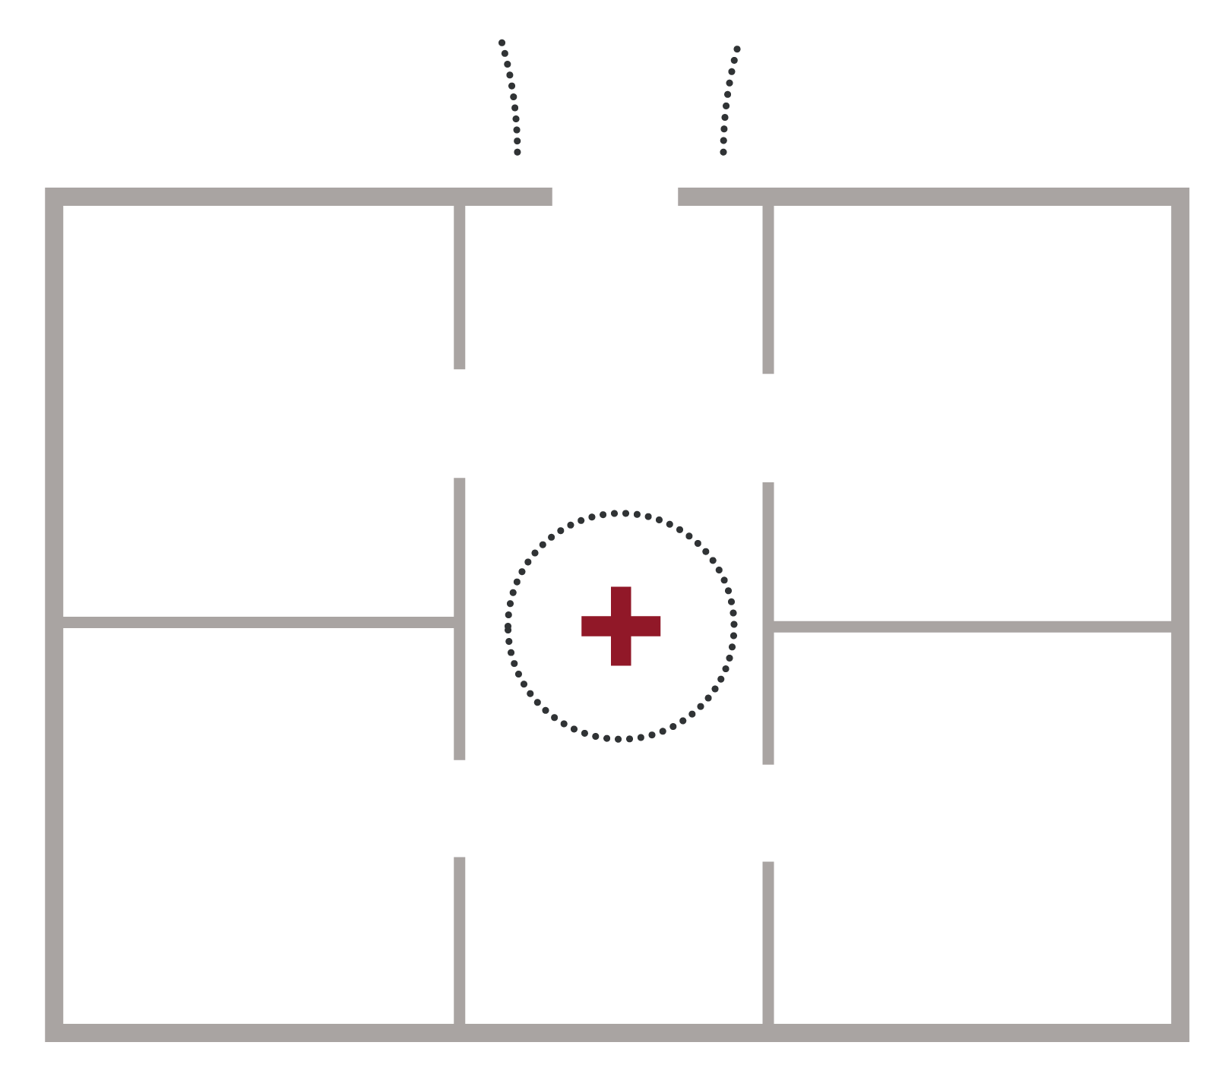
Module 4: Principles and Application of TFC
CASUALTY COLLECTION POINT
LAYOUT consideration (cont.)
Supplies

Slide 34
Module 4: Principles and Application of TFC
CASUALTY COLLECTION POINT
LAYOUT (cont.)
Establish a security perimeter in accordance with unit tactical standard operating procedures and/or battle drills.
Supplies

Slide 35

Module 4: Principles and Application of TFC
CASUALTY COLLECTION POINT
LAYOUT (cont.)
Incoming Casualties
Casualty movement will be provided by unit personnel in accordance with unit tactical operating procedures and/or battle drills.
Supplies

Slide 36
Module 4: Principles and Application of TFC
CASUALTY COLLECTION POINT
LAYOUT (cont.)
Incoming Casualties
TRIAGE
ENTRY/EXIT CHOKEPOINT
Triage/chokepoint will be unit leadership categorizing patients.
Supplies

Slide 37
Module 4: Principles and Application of TFC
CASUALTY COLLECTION POINT
LAYOUT (cont.)
Incoming Casualties
TRIAGE
ENTRY/EXIT CHOKEPOINT
Supplies
IMMEDIATE

Slide 38


Module 4: Principles and Application of TFC
CASUALTY COLLECTION POINT
LAYOUT (cont.)
Incoming Casualties
TRIAGE
ENTRY/EXIT CHOKEPOINT
Supplies
DELAYED
IMMEDIATE

Slide 39



Module 4: Principles and Application of TFC
CASUALTY COLLECTION POINT
LAYOUT (cont.)
Incoming Casualties
TRIAGE
ENTRY/EXIT CHOKEPOINT
Supplies
DELAYED
IMMEDIATE
MINIMAL
/EXPECTANT

Slide 40


Module 4: Principles and Application of TFC
CASUALTY COLLECTION POINT
LAYOUT (cont.)
Incoming Casualties
TRIAGE
ENTRY/EXIT
KIA Morgue should be out of sig^{C}h^{H}t^{OKEPOINT} from casualties suffering life-
threatening trauma. Ensure to havSeupplies
at least one first responder present to protect and guard KIA personnel .
IMMEDIATE
KIA
Morgue
MINIMAL
/EXPECTANT

Slide 41





Module 4: Principles and Application of TFC
CASUALTY COLLECTION POINT
LAYOUT (cont.)
Incoming Casualties
Outgoing Casualties
TRIAGE
ENTRY/EXITTACEVAC CHOKEPOINT
This transition includes preparing the casualty Suppliesfor transport on one of a number of possible
evacuation platforms aircraft, ground vehicles, or watercraft. Some of the essential elements in this preparation are securing loose dressings and straps, casualty marking, and completion of the TCCC Casualty Card. These actions will help to ensure a smooth handover of the casualty to TACEVAC personnel.
DELAYED
KIA
Morgue
MINIMAL
/EXPECTANT

Slide 42

Module 4: Principles and Application of TFC
CASUALTY COLLECTION POINT
LAYOUT (cont.)
Incoming Casualties
Outgoing Casualties
URGENT
PRIORITY
TRIAGE
ENTRY/EXIT CHOKEPOINT
Once moving out with the casualties they will then pre-stage the casualties near the landing zone and prioritize evacuation by establishing who is Urgent, Priority, or Routine.
ROUTINE
Supplies
DELAYED
KIA
Morgue
MINIMAL
/EXPECTANT

Slide 43
Module 4: Principles and Application of TFC
CASUALTY COLLECTION POINT
LAYOUT (cont.)
MEDEVAC
Incoming
Medically regulated^{O}ca^{u}s^{t}u^{g}alºty^{i}m^{n}o^{g}vement using dedicated medical
Casualties
evacuation platformCs.aTsheusae latrieecsrewed by medical attendanUtRsGENT and generally have more medical treatment equipment available
than nonmedical platforms. MEDEVAC platforms are
PRIORITY
MEDEVAC
prTeRdIeAsGigEnated assets that bear Red Cross markings and carry n^{E}o^{NT}o^{R}ff^{Y}e/n^{E}s^{X}i^{I}v^{T}e weaponry such as rockets or missiles. MEDEVARCOUTINE ^{C}m^{H}o^{O}v^{K}e^{E}m^{PO}en^{IN}t^{T}s may include both clearing casualties from the
battlefield and moving casualties between medical treatment facSiluitpiepsli.es
DELAYED
IMMEDIATE
CASEVAC
KIA
Morgue
MINIMAL
/EXPECTANT

Slide 44


Module 4: Principles and Application of TFC
CASUALTY COLLECTION POINT
LAYOUT (cont.)
TACEVAC
Incoming Casualties
Outgoing Casualties
URGENT
PRIORITY
MEDEVAC
TRIAGE
ENTRY/EXIT CHOKEPOINT
ROUTINE
_{CAS}S_{E}u_{V}p_{A}p_{C}lies
IMMEDIATE
DELAYED
CASEVAC
The unregulated movement of casualties from the point of wounding to the first point of surgical care (Role II Surgical Capability or Role III Theater Medical Treatment Facility). CASEVAC platforms are typically armed tactical assets that bear no Red Cross markings. These may be aircraft, vehicles, or maritime vessels of opportunity.
KIA
Morgue
MINIMAL
/EXPECTANT

Slide 45
Module 4: Principles and Application of TFC
CASUALTY COLLECTION POINT
LAYOUT (cont.)
Incoming Casualties
Outgoing Casualties
URGENT
PRIORITY
MEDEVAC
TRIAGE
ENTRY/EXIT CHOKEPOINT
ROUTINE
Supplies
CASEVAC
IMMEDIATE
DELAYED
KIA
Morgue
MINIMAL
/EXPECTANT

Slide 46
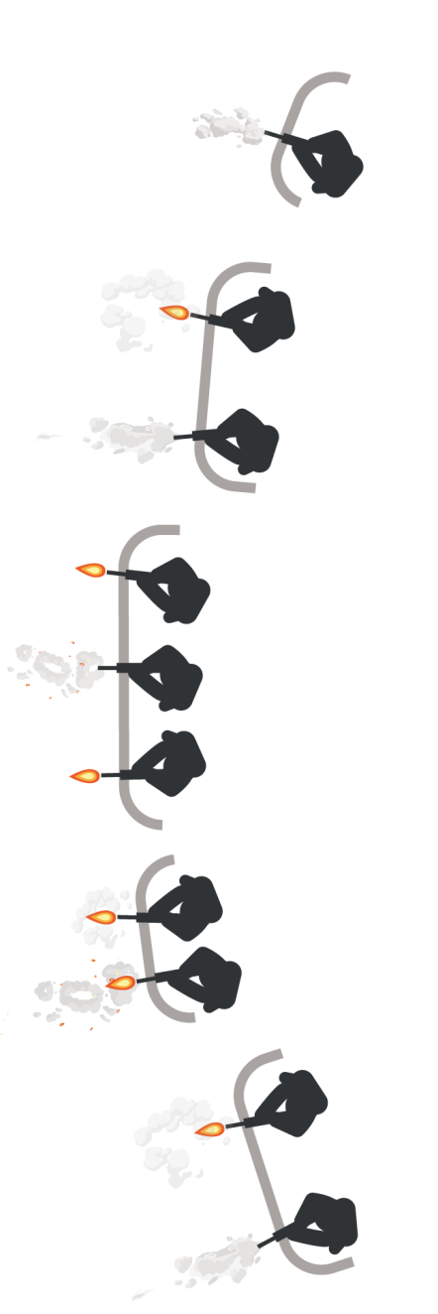
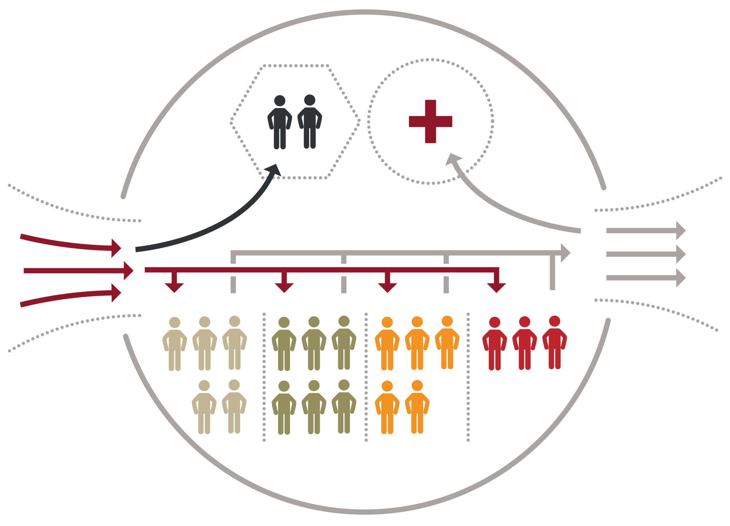

Module 4: Principles and Application of TFC
CASUALTY COLLECTION POINT
LAYOUT AND RESPONSIBILITY considerations
KIA Morgue
Supplies
Incoming Casualties
Outgoing Casualties
TRIAGE
ENTRY CHOKEPOINT
EXIT CHOKEPOINT
ROUTINE
PRIORITY
URGENT
Minimal/Expectant
Delayed
Immediate

Slide 47

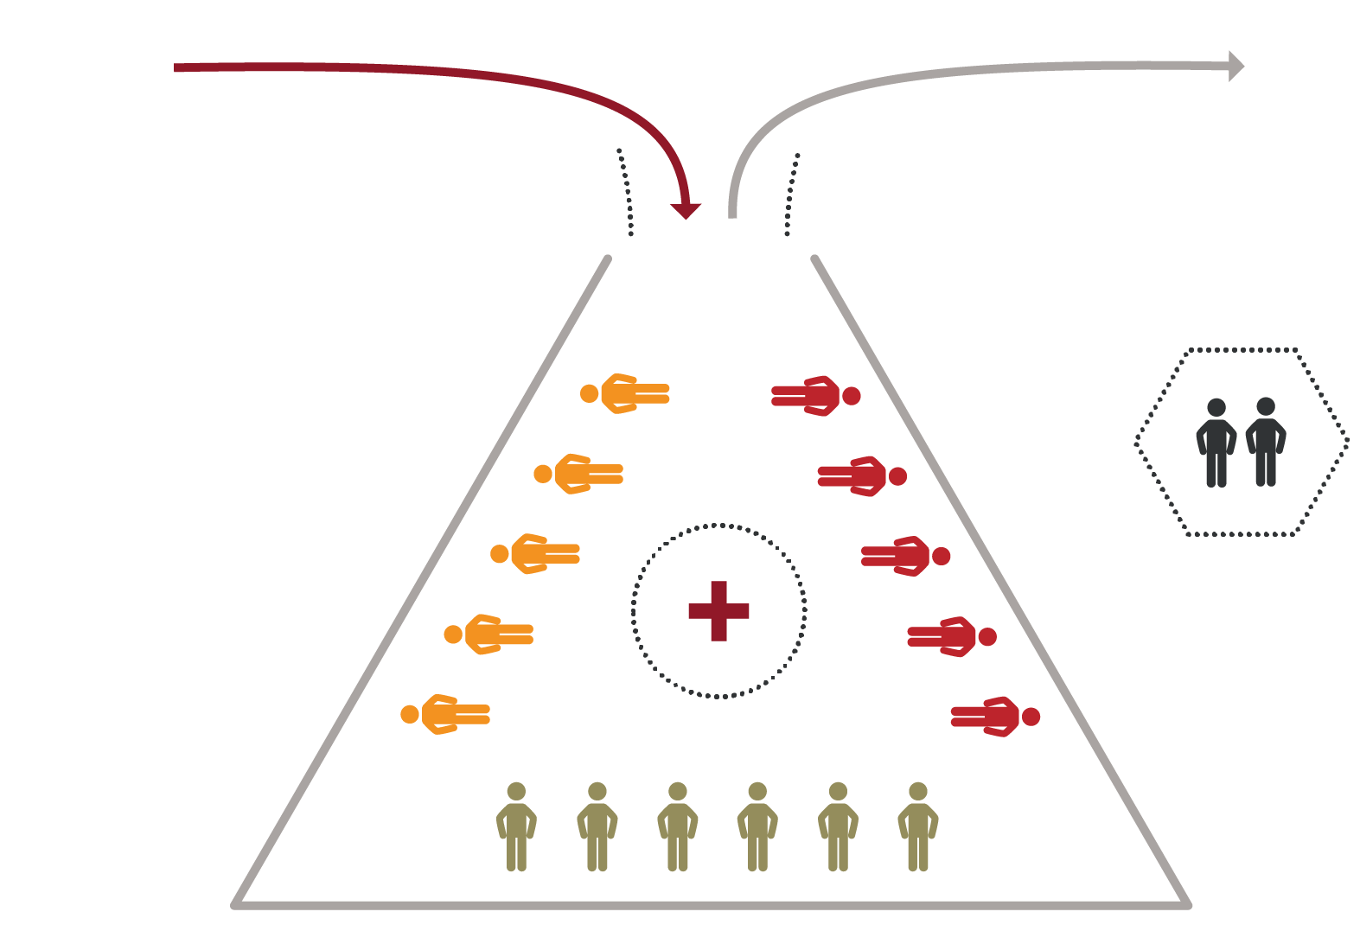
Module 4: Principles and Application of TFC
CASUALTY COLLECTION POINT
LAYOUT (cont.)
Incoming Casualties
Outgoing Casualties
TRIAGE
ENTRY/EXIT CHOKEPOINT
Delayed
Immediate
KIA
Morgue
URGENT
ROUTINE
Supplies
PRIORITY
Minimal/Expectant

Slide 48
SUMMARY
Module 4: Principles and Application of TFC
What is TACTICAL FIELD CARE?
SECURITY AND TACTICAL SAFETY MARCH PAWS
COMMUNICATION
TRIAGE CONSIDERATIONS CASUALTY COLLECTION POINT

Slide 49

CHECK ON LEARNING
What is the difference between TFC and CUF?
True or False: During TFC, the tactical situation could change back to CUF again at any time.
What is MARCH PAWS? What is triage?
What is a CCP?

Slide 50



ANY QUESTIONS?

Slide 51

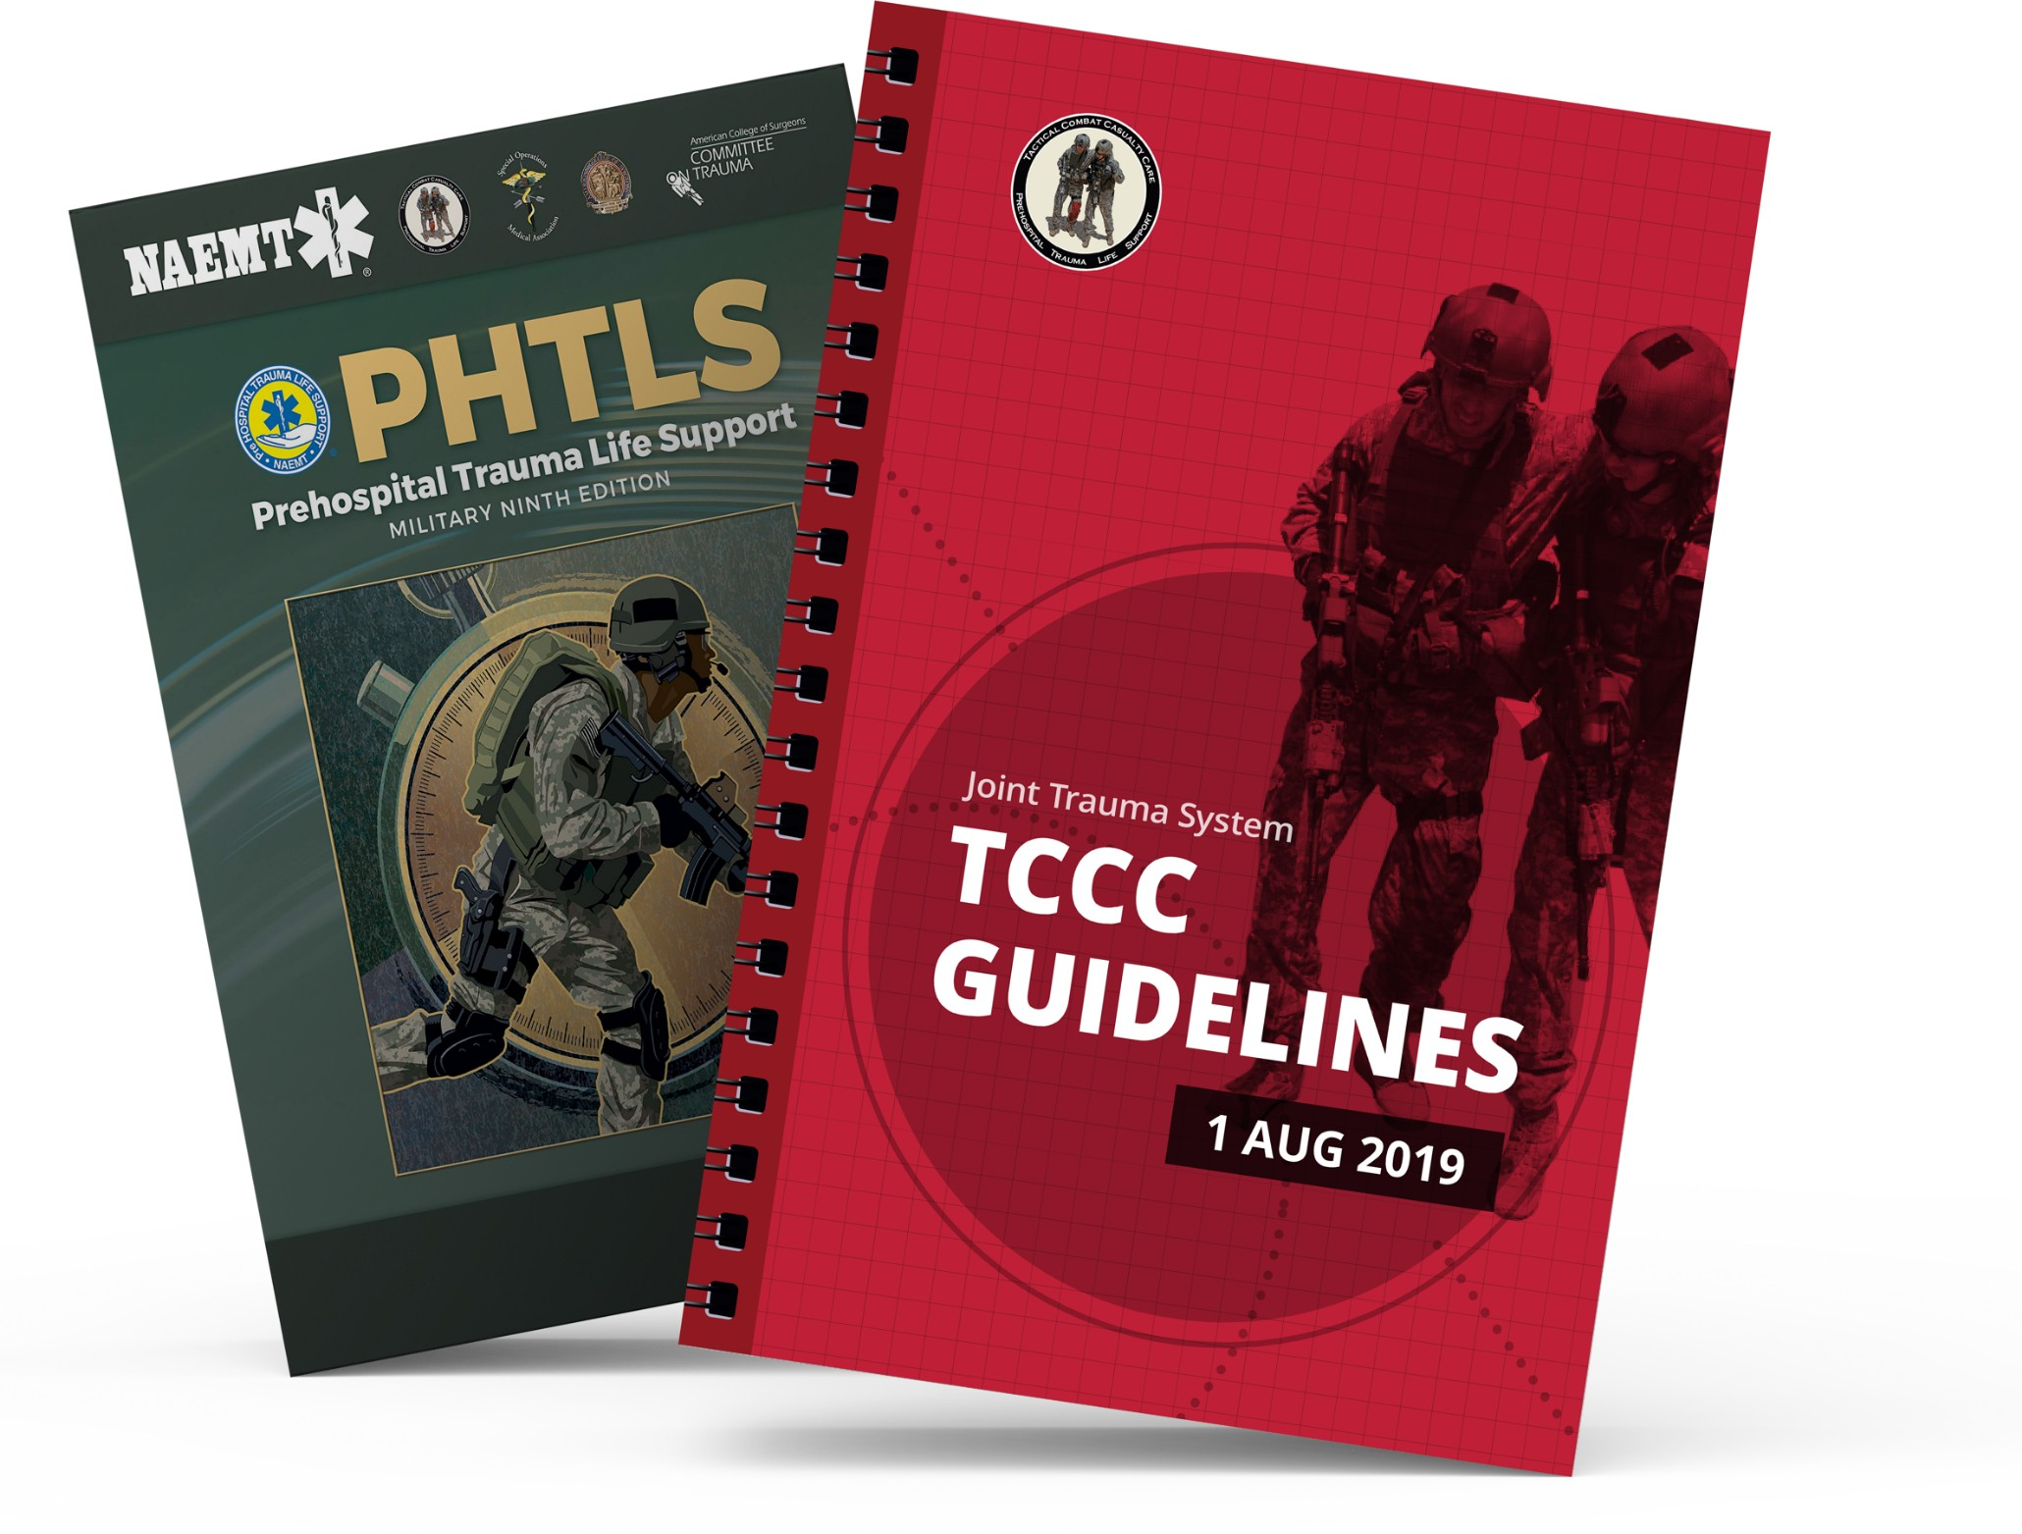
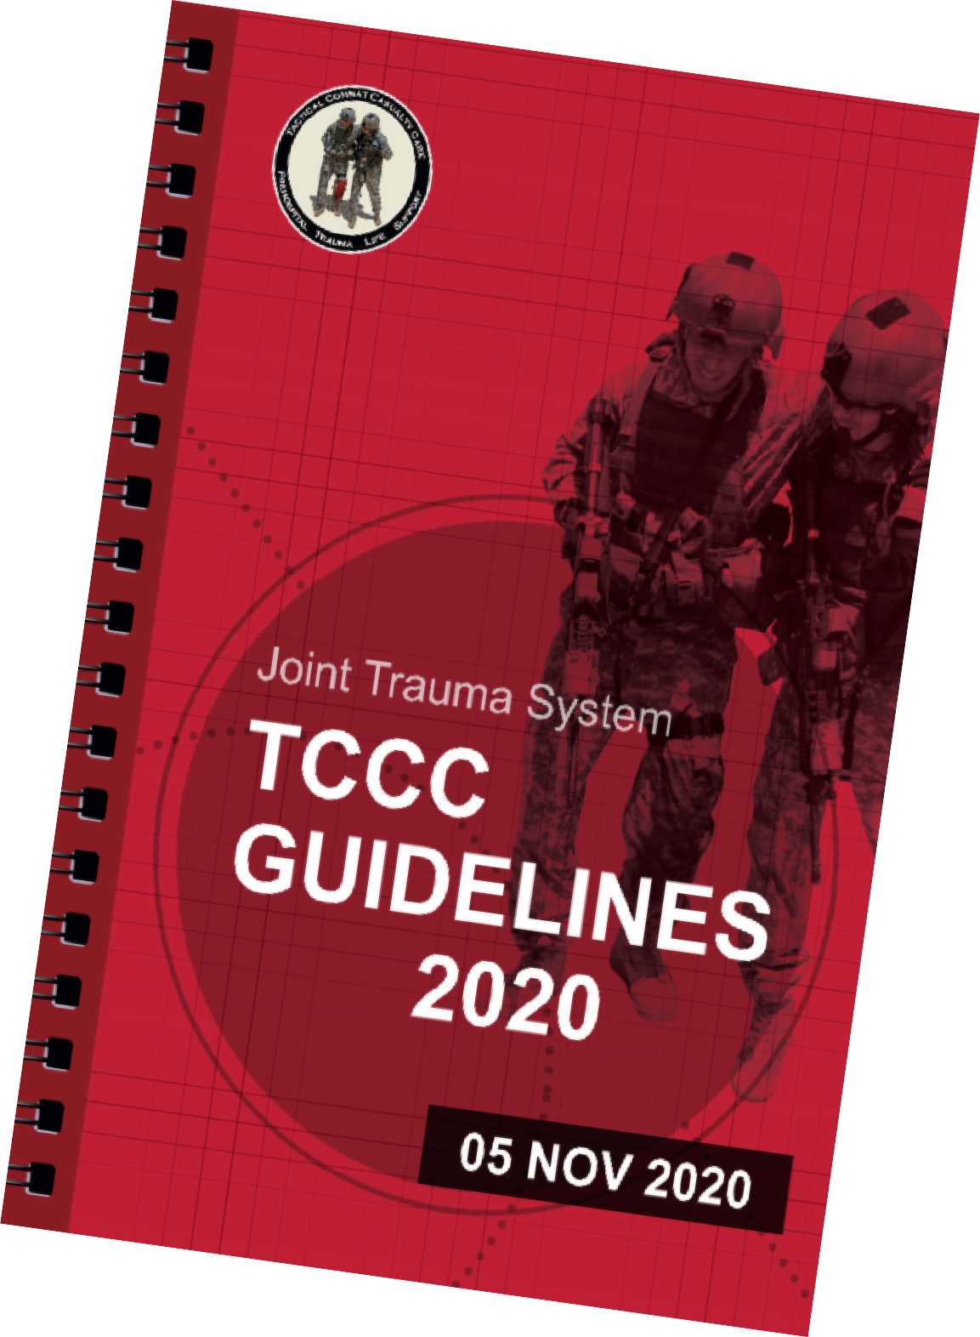
REFERENCES
Module 4: Principles and Application of TFC
TCCC: Guidelines
by JTS/CoTCCC
The latest edition is dated 05 November 2020. These guidelines, updated regularly, are the result of decisions made by CoTCCC in exploring evidence- based research on best practices.
PHTLS: Military Edition
by NAEMT
Prehospital Trauma Life Support (PHTLS), Military Edition, teaches and reinforces the principles of rapidly assessing a trauma patient using an orderly approach.

